Slide 1
Chance 掌握智權先機──透析論文與專利優勢
陳省三 博士
10-28-2015

Slide 2
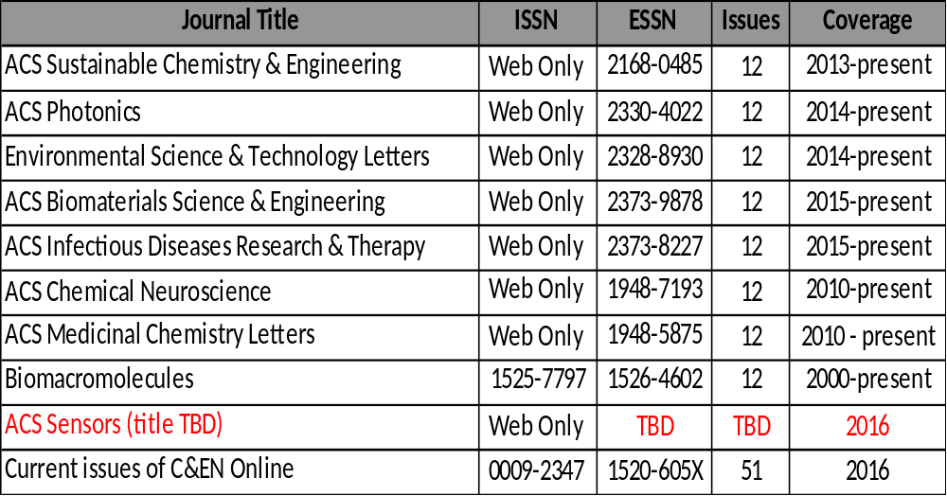
ACS Publication-1

Slide 3
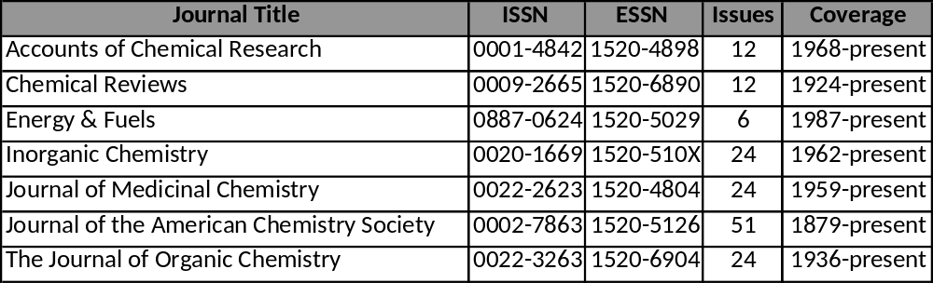
ACS Publication-2

Slide 4
Silicon Photonic 定義
經過多年的研究結果，Intel矽光子傳輸技術終於做出點樣子了，這項顛覆傳統以電作為資料傳輸介質的技術，將挑戰電腦內部數據傳輸的極限。 目前的電傳輸面臨幾個問題，首先是電路之間傳輸造成的電磁干擾，尤其在製成不斷精進，線路越來越近，干擾的狀況也更為嚴重，小則影響傳輸品質，大則甚至導致系統停擺；再者會遇到電傳輸速度的極限問題，畢竟電的傳輸速度仍較光為慢。從過去以來，科學家就不斷思考如何使用光取代電作為傳輸的方式；過去光傳輸最麻煩的問題就是需要在收發兩端配備光電轉換的架構，使光轉換成可識別的信號。
矽光子學(Silicon Photonics)的目標是發展出可操縱光訊號、奈米等級的積體化晶片，將無數個光學元件整合於其上，能夠像現在我們在晶片上操縱電一般的操控光。

Slide 5
Research Topic:
Silicon Photonic Patent
84 Patents
Example: WO 2015147966
Silicon-​photonics-​based optical switch

Slide 6
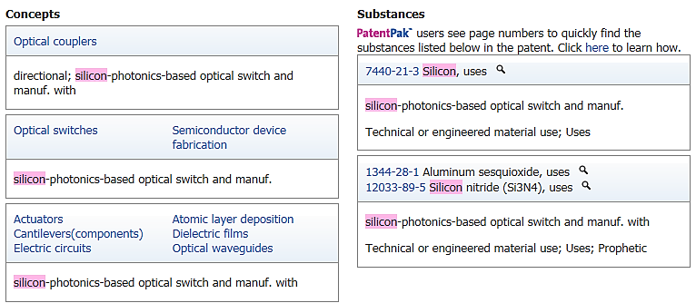
WO 2015147966

Slide 7
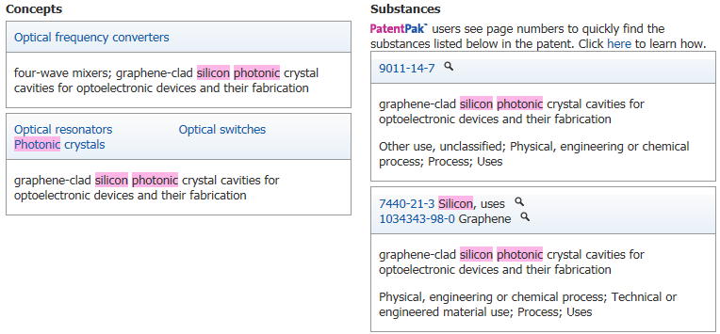
US 20140329050

Slide 8
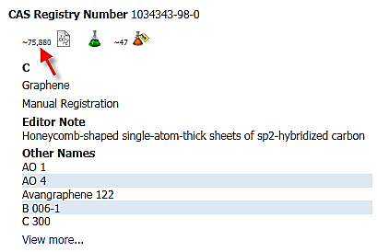
Graphene

Slide 9
Research Topic:
Silicon Photonic Journal
1,704 Articles in total > 1,385 from Journals > 418 of 1385 published after 2013 >Top 20 impacted articles of 418 from 7 publishers
→25% from ACS journals
Example: Nano Letters, Volume13,Issue2, Pages 515-518
Electrical Control of Silicon Photonic Crystal Cavity by Graphene.

Slide 10
Research Topic:
Silicon Photonic Report
43 Reports
Example: JAEA-Review, Issue2007-049, Pages 41-44
Development of bonded semiconductor device for high counting rate high efficiency photon detectors

Slide 11
Research Topic:
Silicon Photonic Review
131 Reviews
Example: Optics Communications, Pages Ahead of Print
Passive silicon photonic devices for microwave photonic signal processing

Slide 12
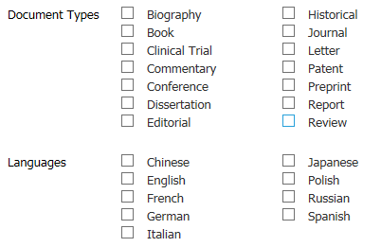
Document Types

Slide 13
Research Topic:
Antidepressant Drug Patent
101 Patents
Example: WO 2015136446
Methods for selecting antidepressant drug therapy to treat depression based on single nucleotide polymorphism in MTHFR, MTR, GCH1 or COMT genes

Slide 14
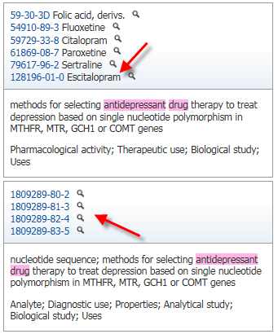
WO 2015136446

Slide 15
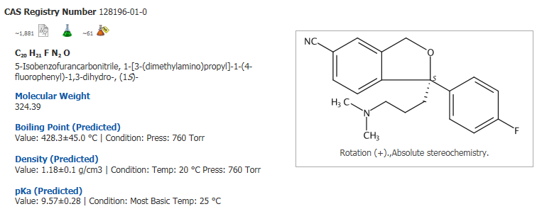
RN: 128196-01-0

Slide 16
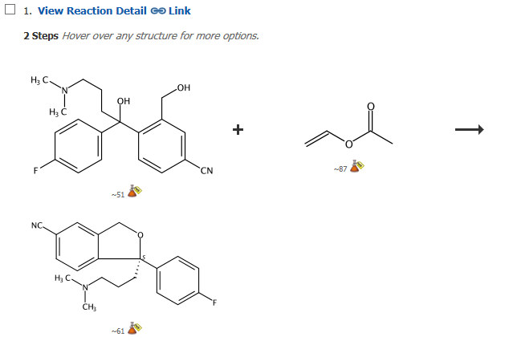
Reactions: Product

Slide 17
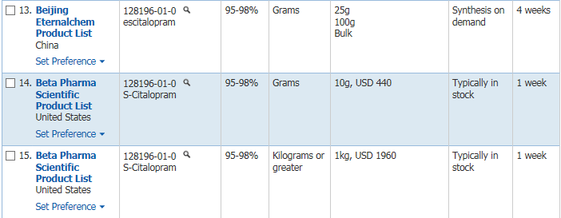
Commercial Sources

Slide 18
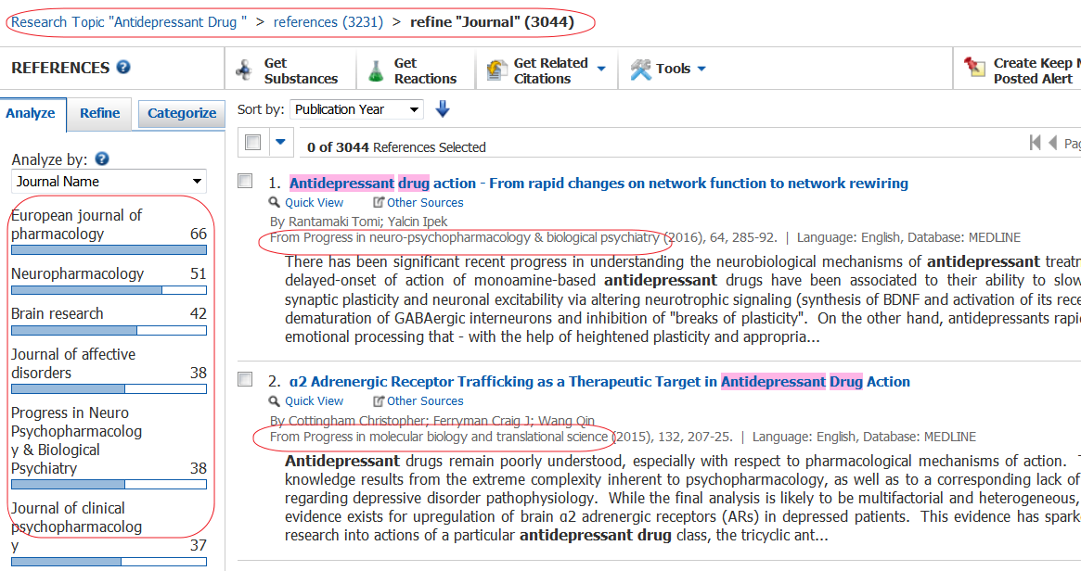
Research Topic:
Antidepressant Drug Journal
3,044 of 3,231 articles from journals (but many from medical journals: European journal of pharmacology, Neuropharmacology…)
How to link chemistry and antidepressant drug ?

Slide 19
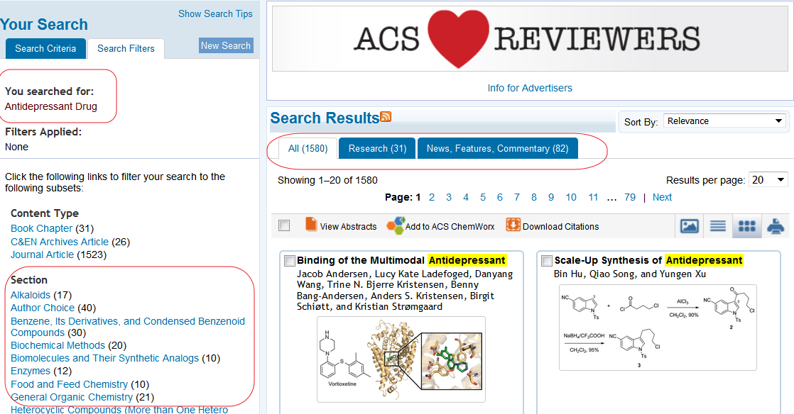
Research Topic:
Antidepressant Drug in ACS Journal
1580 articles from ACS journals
Easily link chemistry and antidepressant drug by different sections (example: biochemical methods, biomolecules and their synthetic analogs)

Slide 20
Research Topic:
Antidepressant Drug Clinical Trial or Conference
294 Articles
Example: Handbook of Metabolic Pathways of Xenobiotics Volume5 Pages 1957-1959 Paroxetine

Slide 21
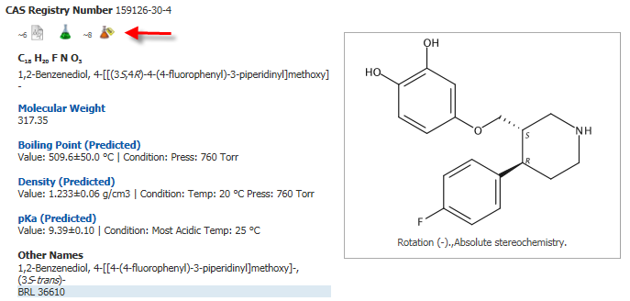
RN: 159126-30-4

Slide 22
Research Topic:
New Polymer and Toray Patent
8 Patents
Example: KR 2014078825
Interlayer insulating film with filling layer consisting of thermosetting liquid crystal polymer, and a semiconductor package substrate using the same

Slide 23
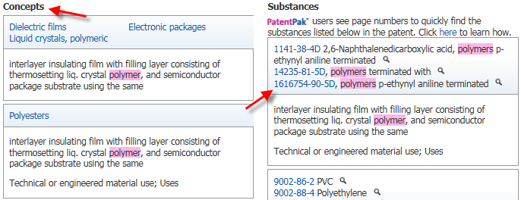
KR 2014078825

Slide 24
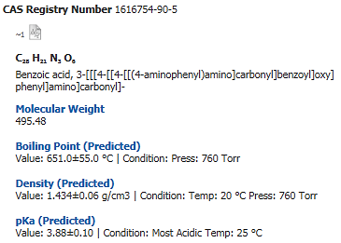
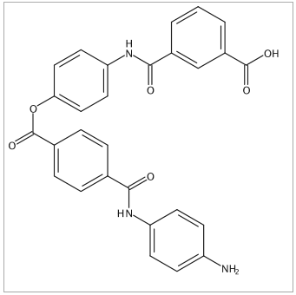
RN: 1616754-90-5

Slide 25
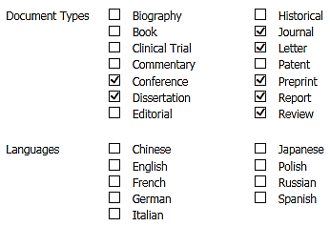
Research Topic:
New Polymer and Toray NPL

Slide 26
Research Topic:
New Polymer and Toray NPL
2 Articles
Example: Journal of Applied Polymer Science
Volume93, Issue6, Pages 2642-2649
New liquid polysulfide polymer terminated with silyl group

Slide 27
Need more research full-text?

Slide 28
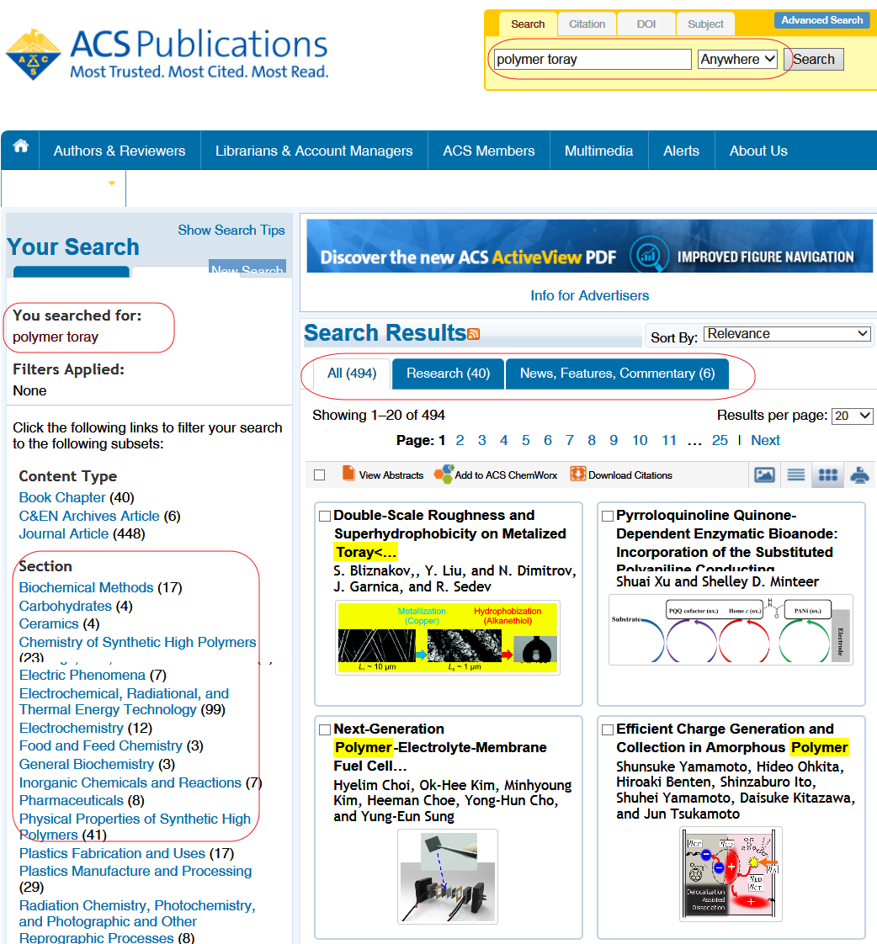
Research Topic:
Polymer Toray in ACS Journals
494 articles from sections:
Biochemical -methods, Carbohydrates,
Ceramics…

Slide 29
Antidepressant Drug
3,230 Articles

Slide 30
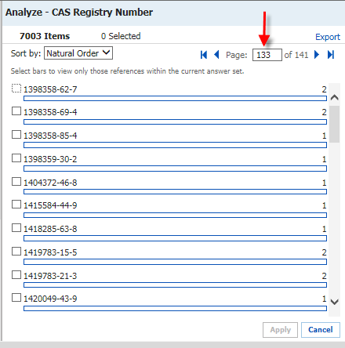
CAS Registry Number

Slide 31
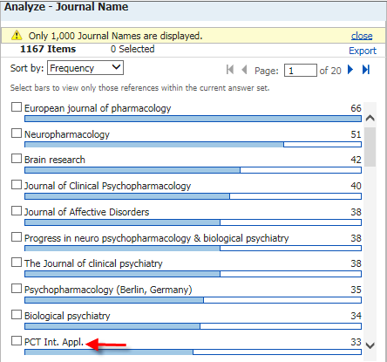
Journal Name

Slide 32
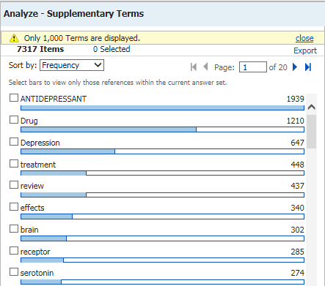
Supplementary Terms

Slide 33
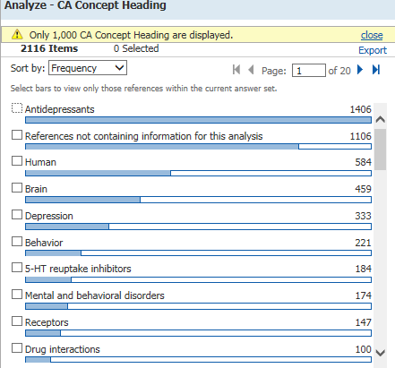
CA Concept Heading

Slide 34
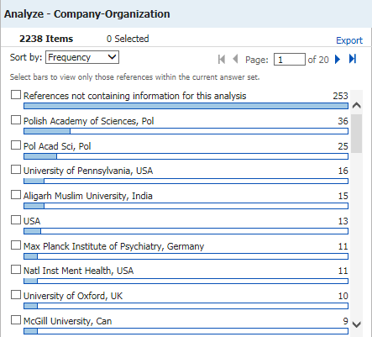
Company-Organization

Slide 35
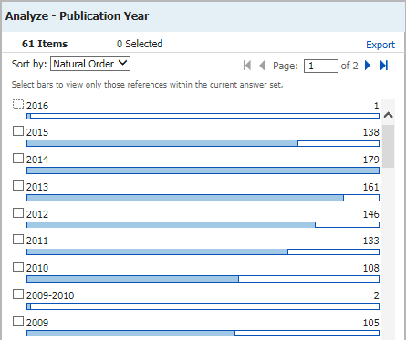
Publication Year

Slide 36
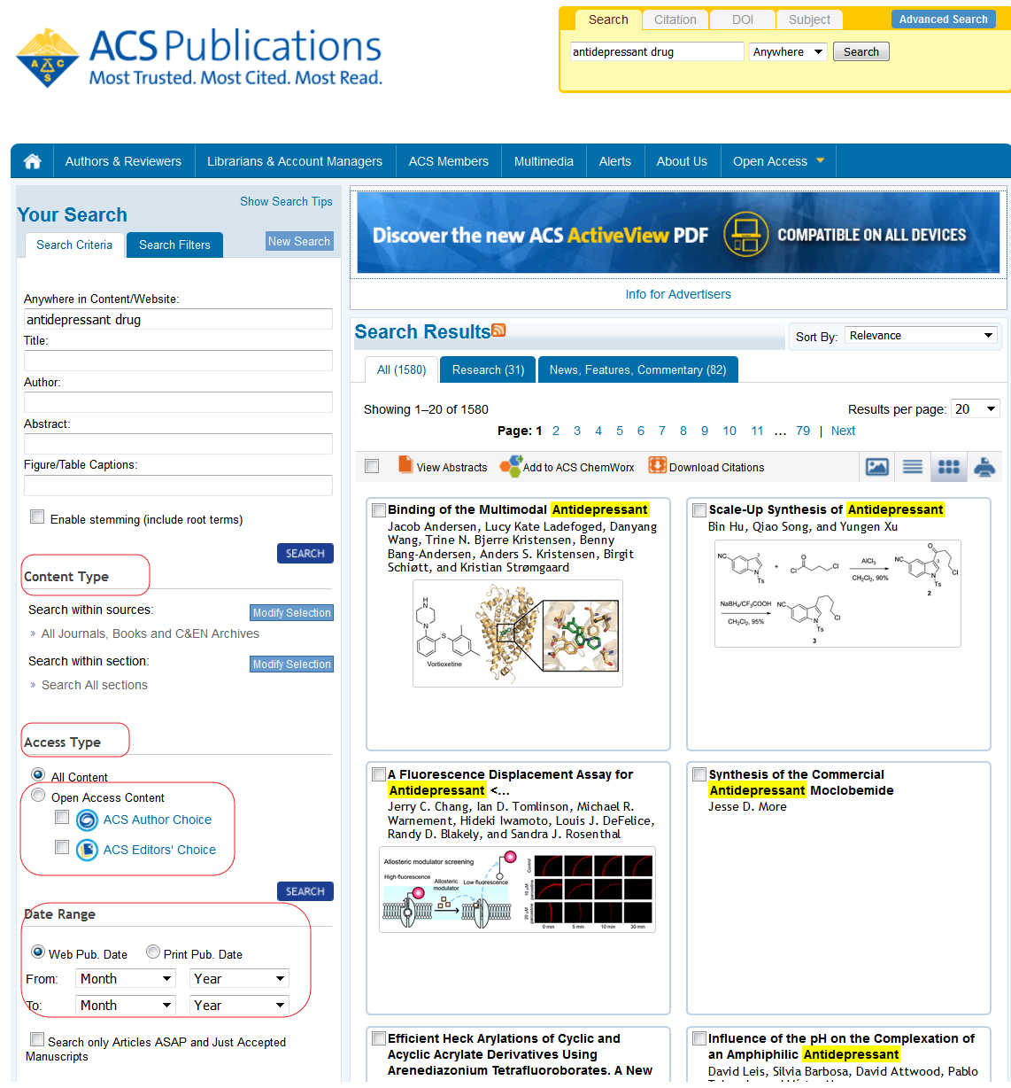
ACS Publication Platform
Antidepressant Drug 1,580 articles

Slide 37
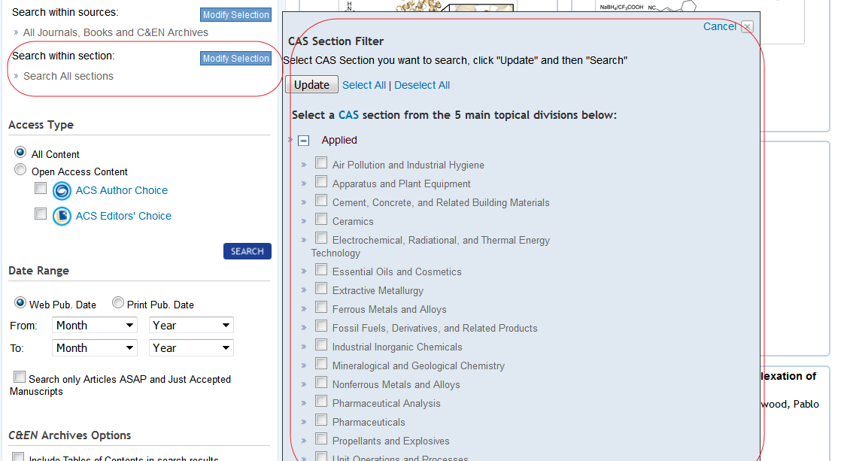
Filter by CAS section or year

Slide 38
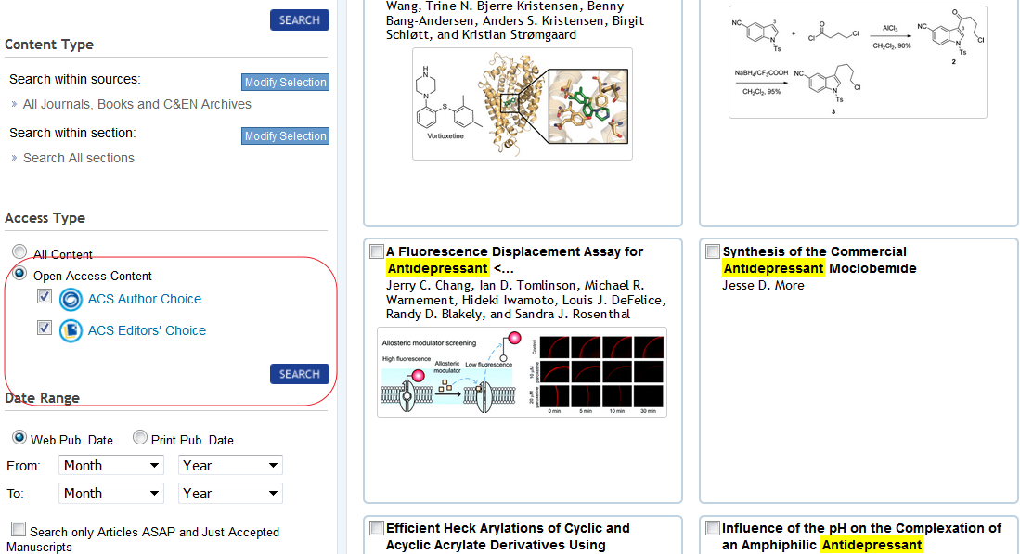
Open accessible (free) articles about antidepressant or drugs

Slide 39
Thanks for your attention

